Slide 1
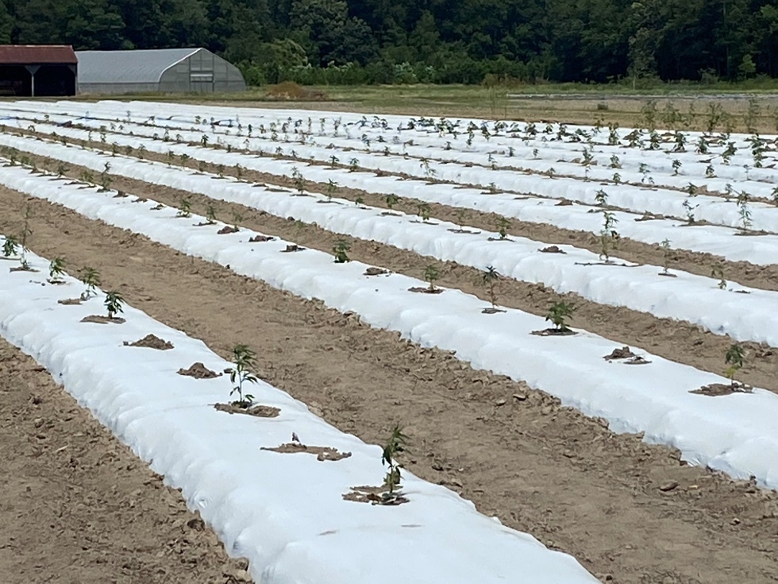
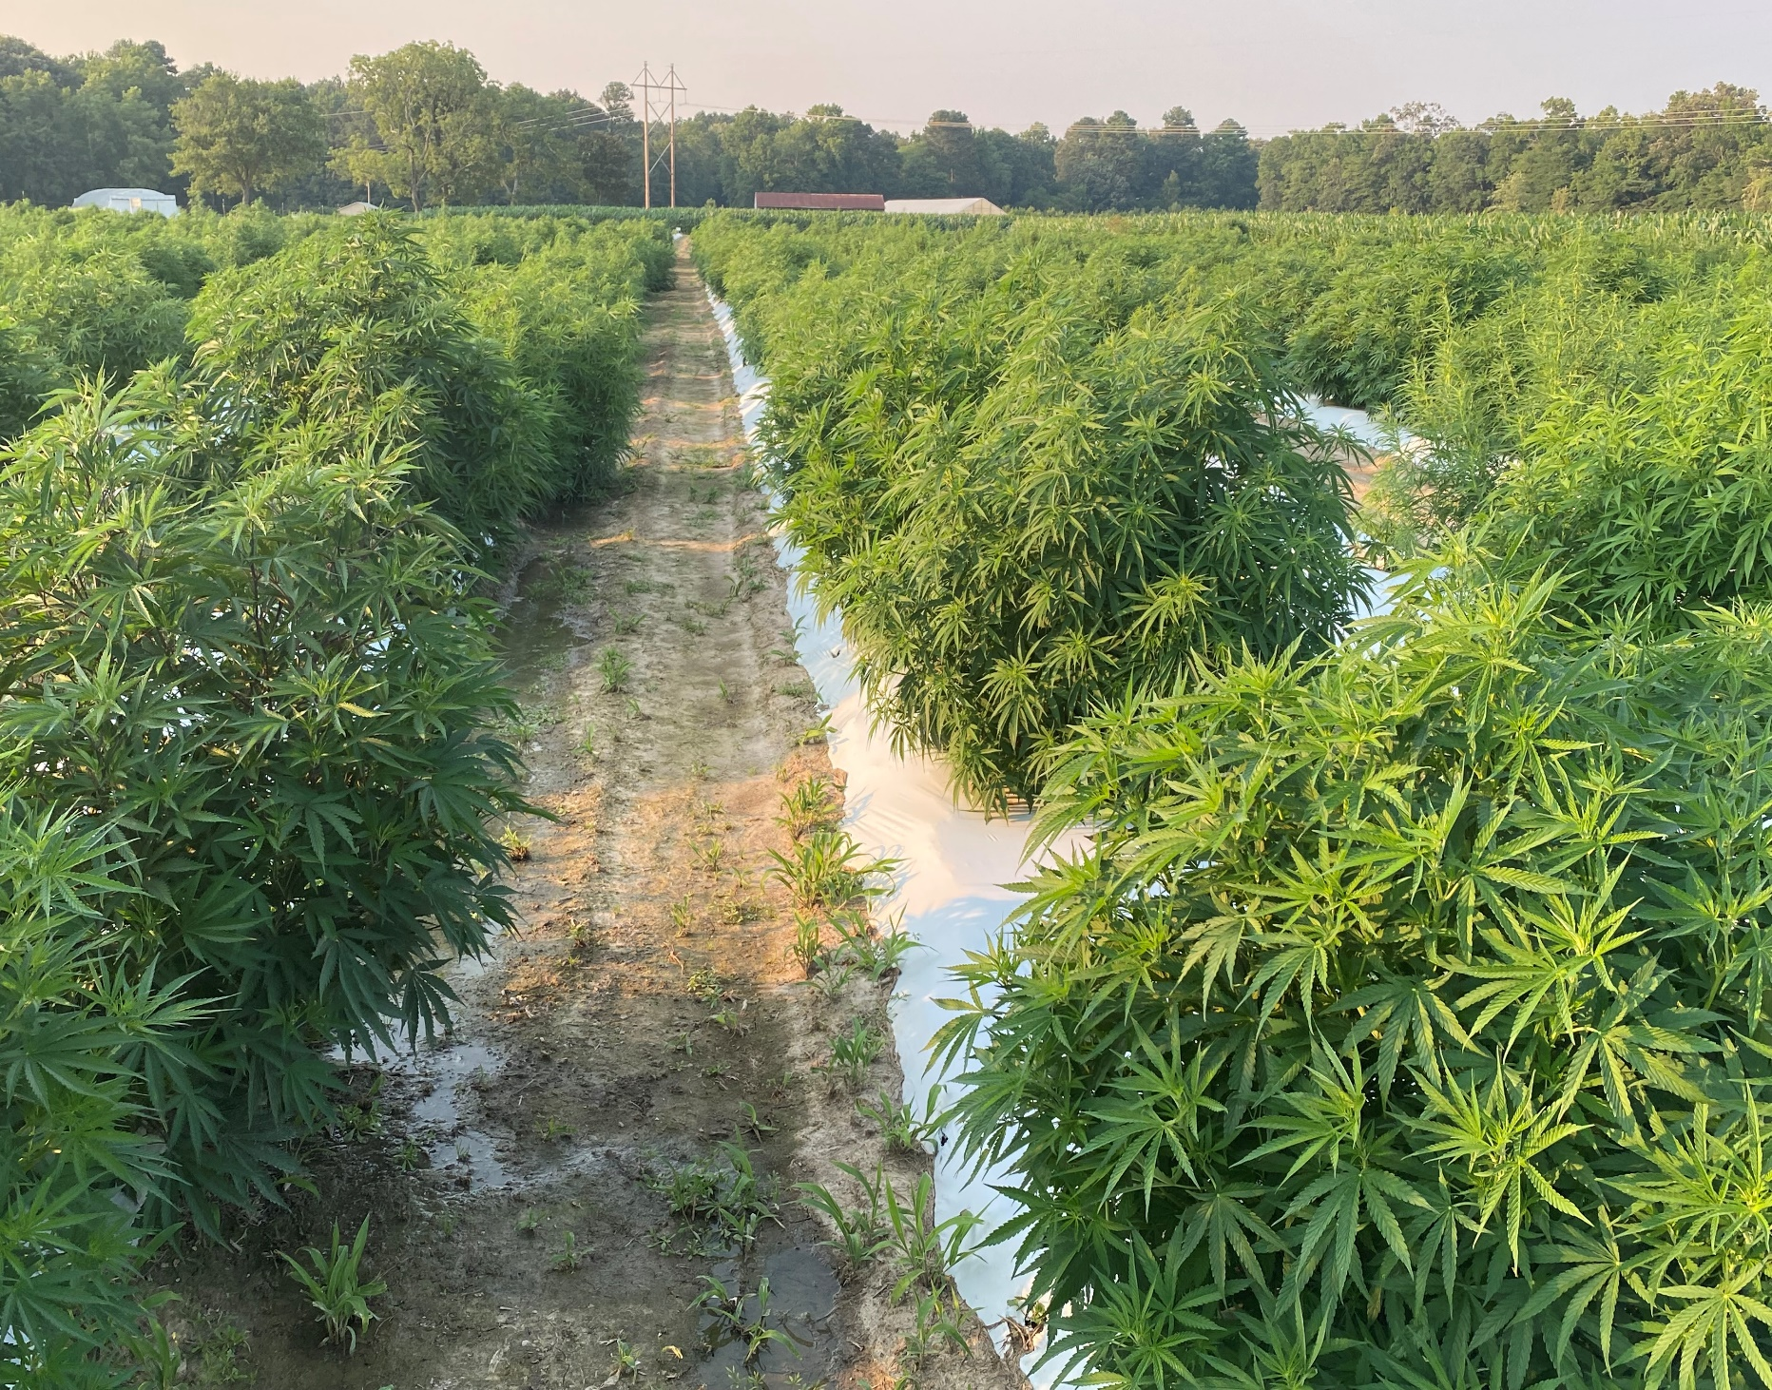
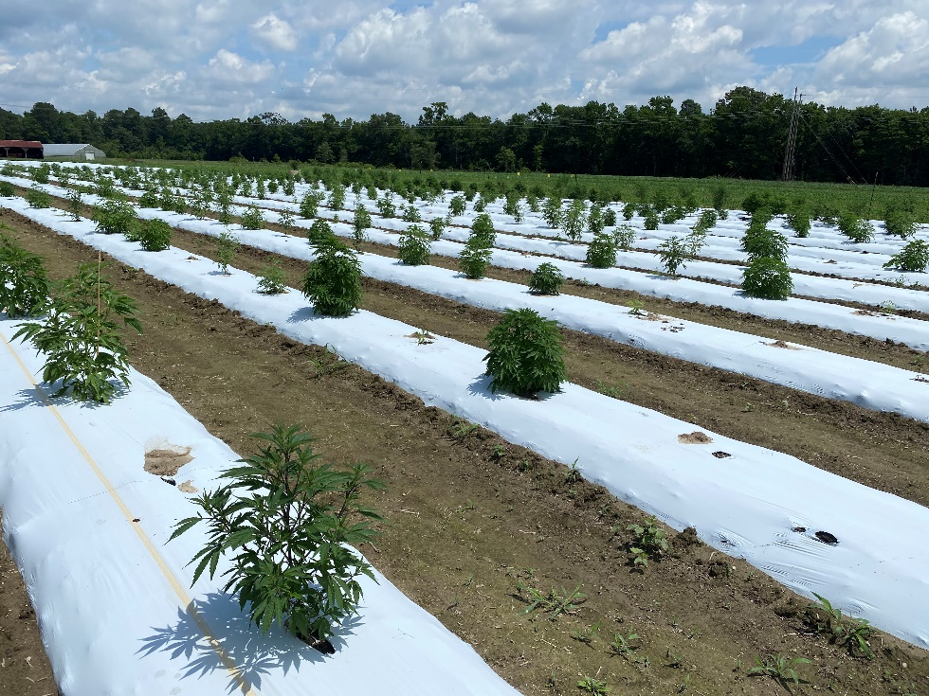
Field Screening of Hemp Cultivars
Planting day
30 days-post planting
60 days-post planting

Slide 2
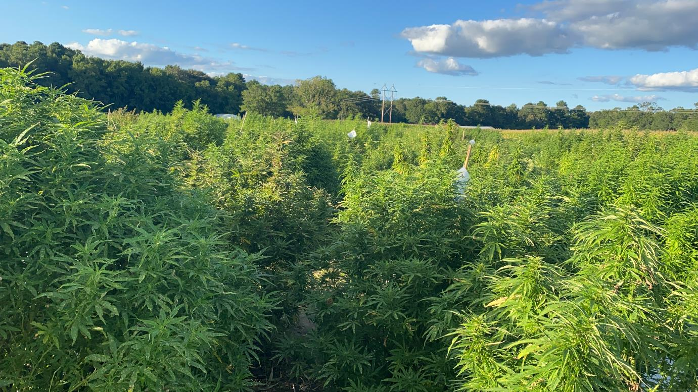
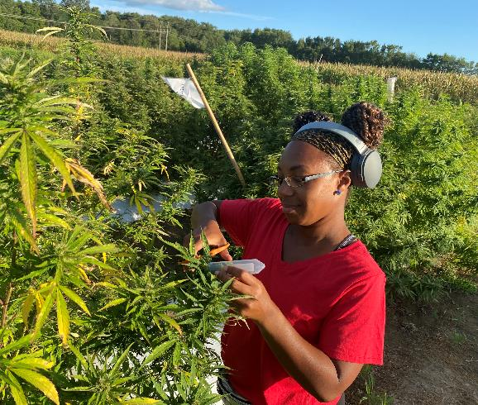
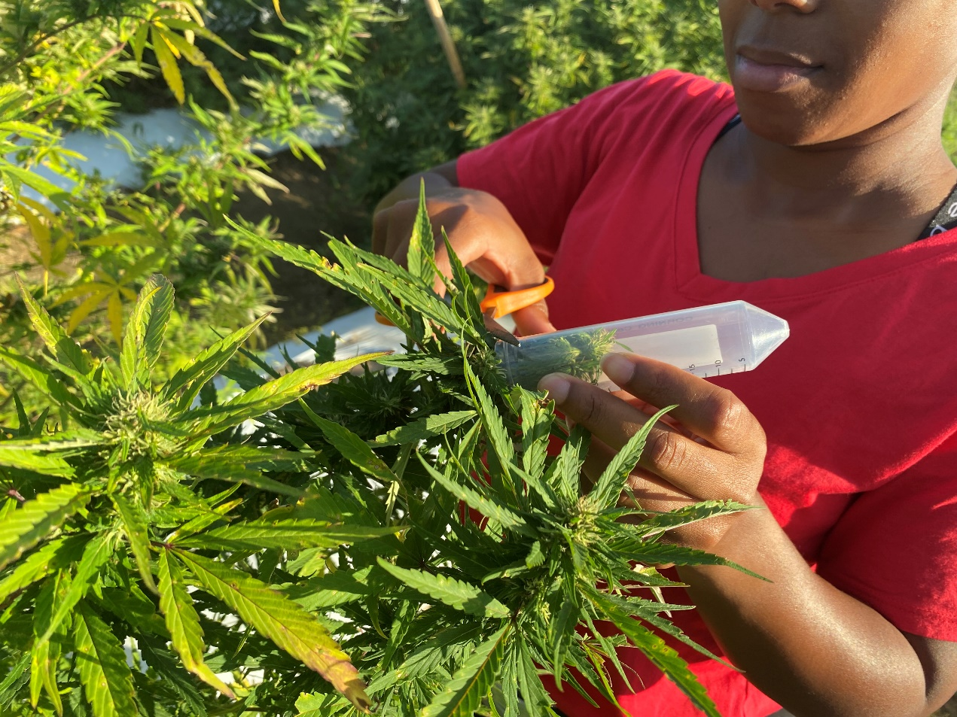
Field Screening.. Hemp Cultivars in Flowering
Field at flowering stage
Student collecting flower sample collection for THC testing

Slide 3
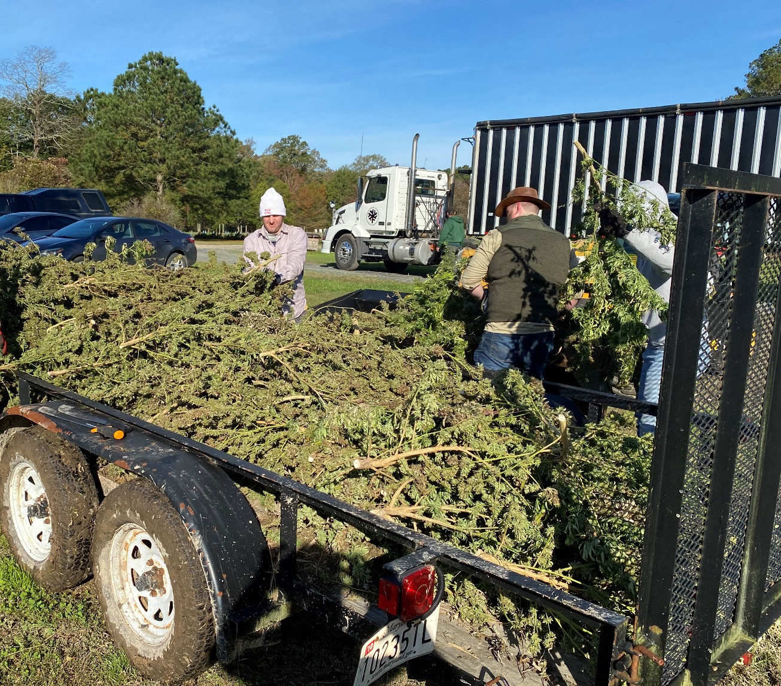
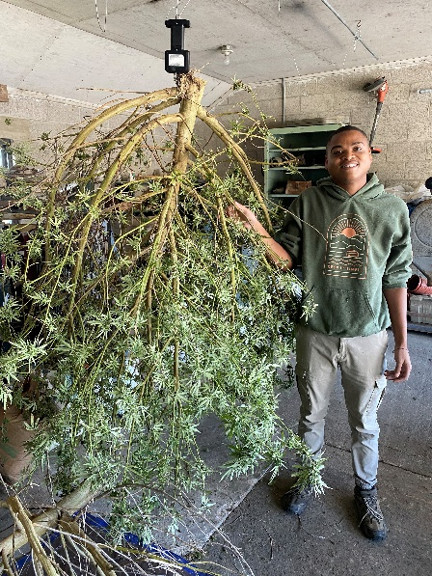
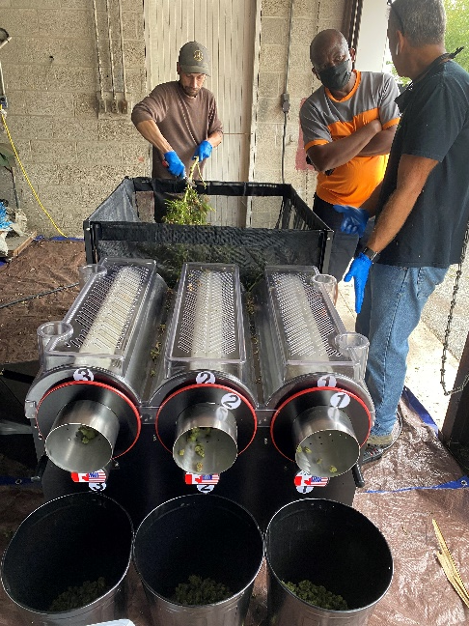
Harvesting and Post-Harvest Processing
Harvesting hemp from the field
Drying hemp plants
Stripping and trimming flowers

Slide 4
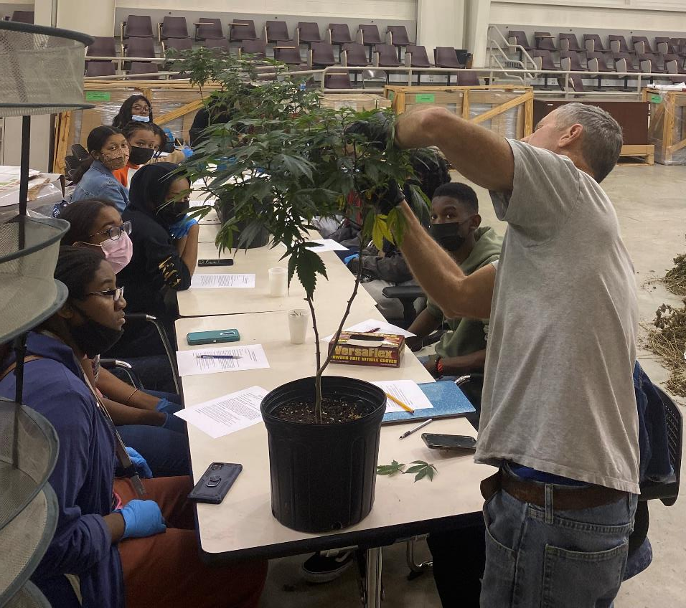
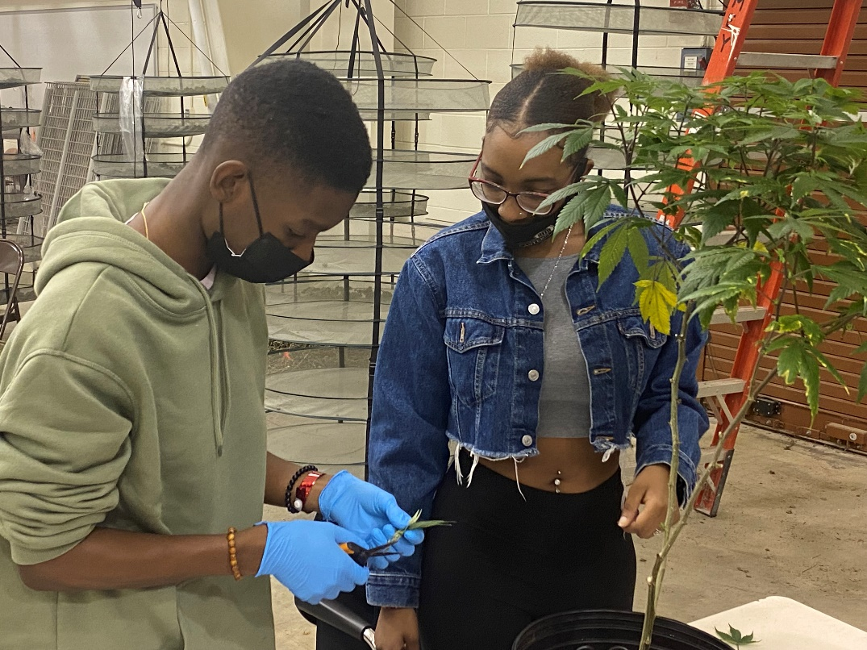
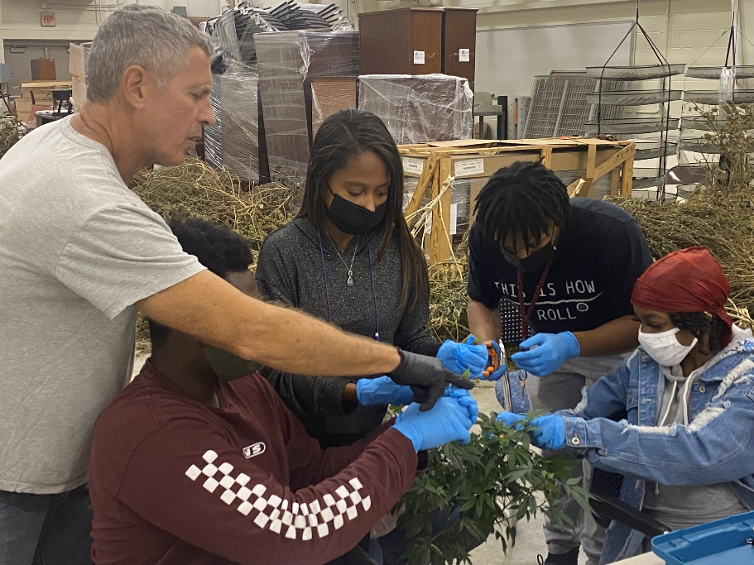
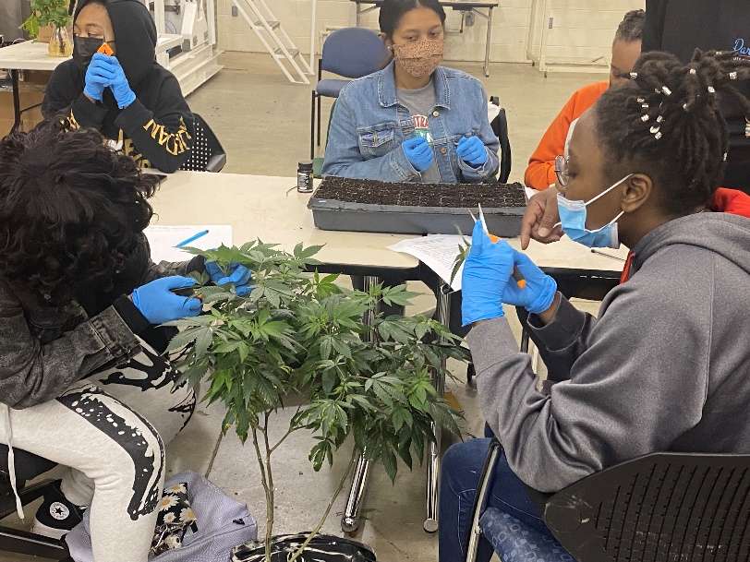
Student Training in Plant Propagation
Technician Michael Foland demonstrating plant propagation
Students practicing propagation by softwood cuttings

Slide 5
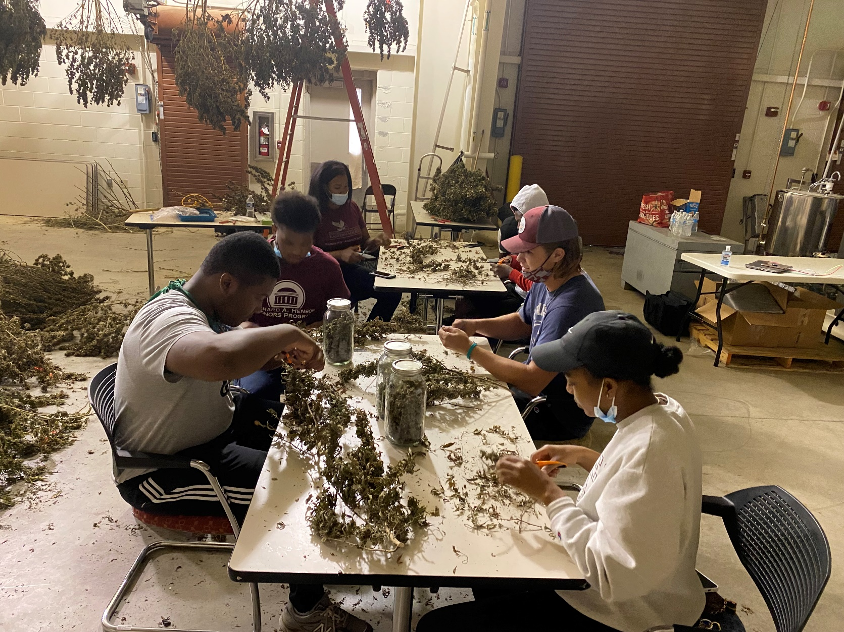
Student Training in Flower Trimming
Students practicing trimming of dried flowers

Slide 6
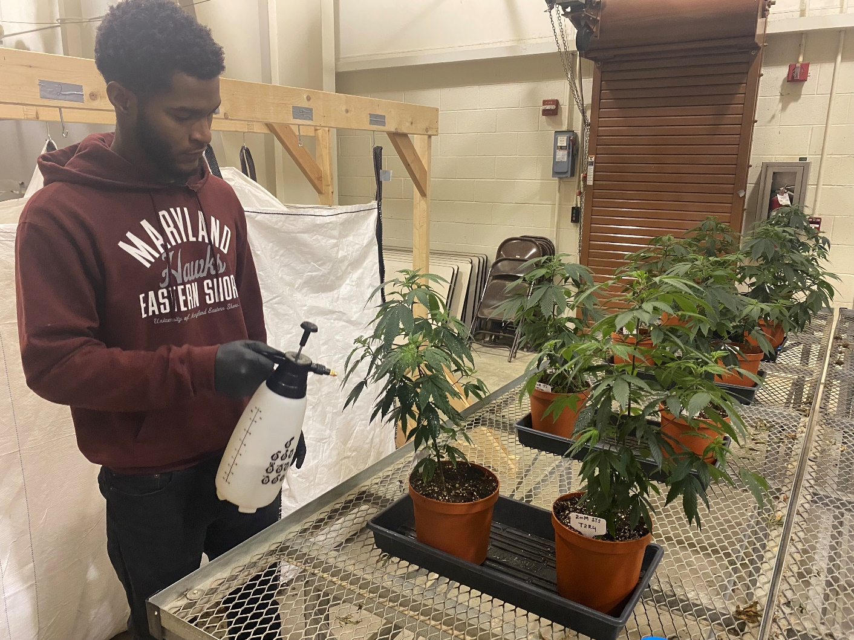
Training Students in Hemp Seed Feminization
Students spraying Silver Thiosulfate Solution to induce male flower production in female plants

Slide 7
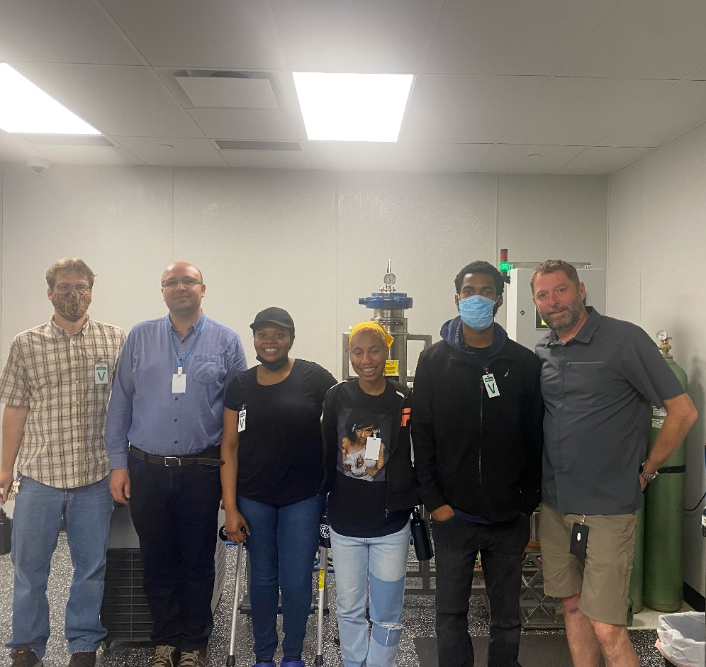
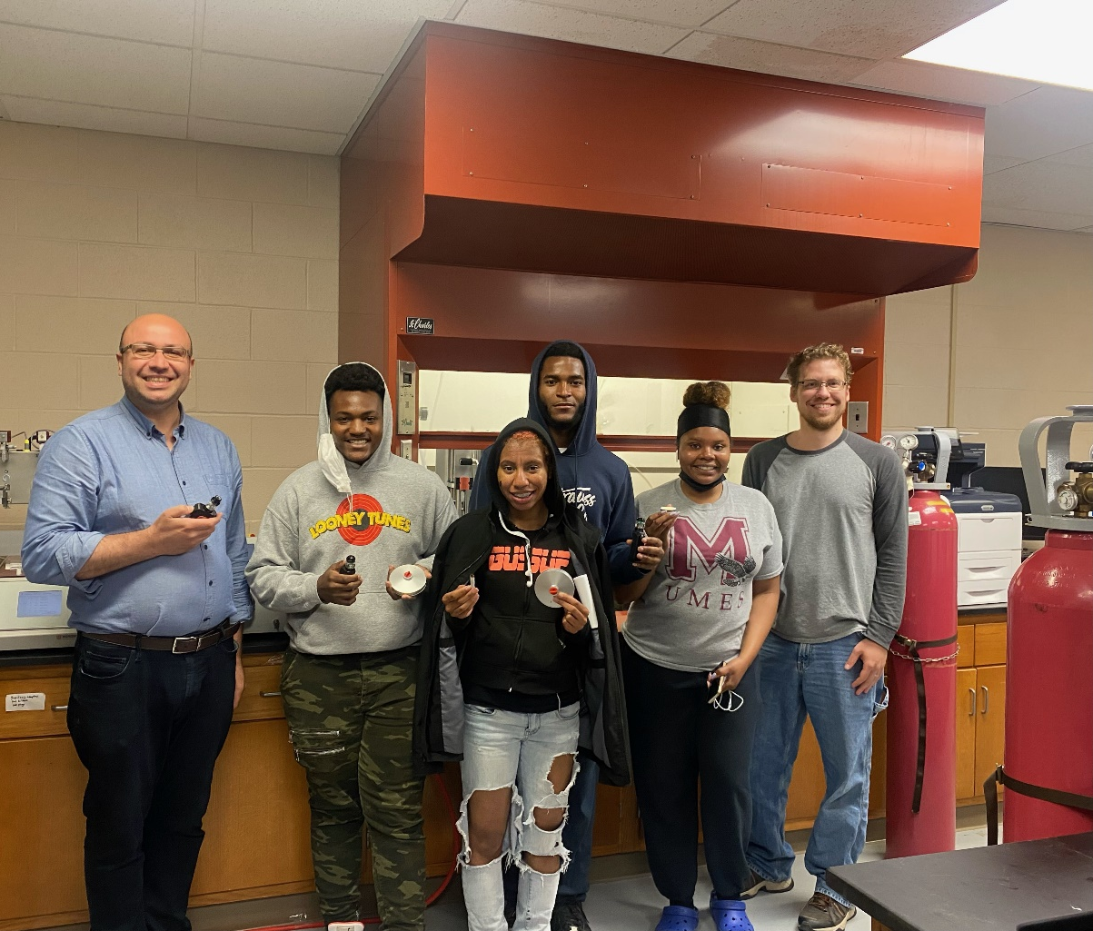
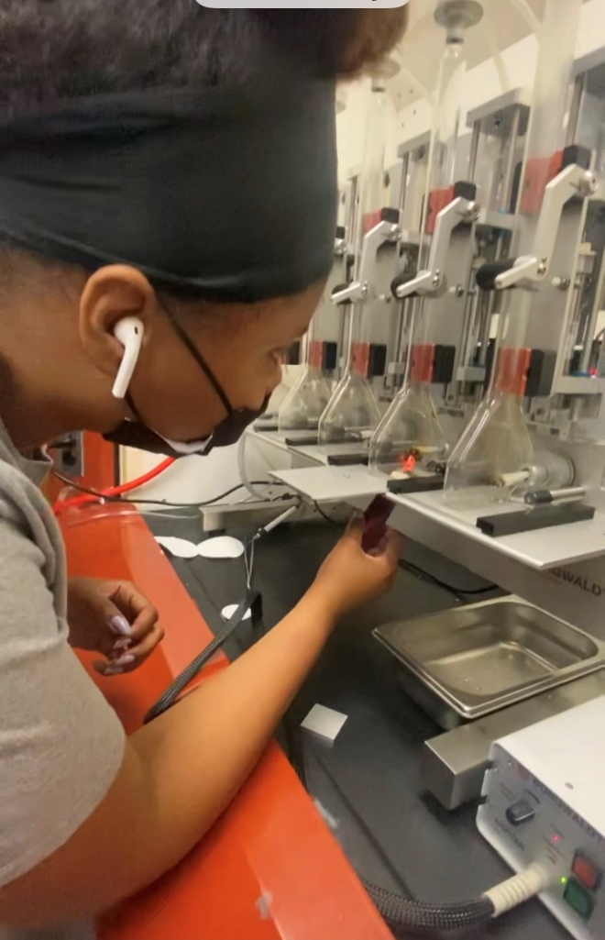
Student Visit to Central State University
Students visit to CSU
Student training in hemp analytical chemistry
Testing smoke machines

Slide 8
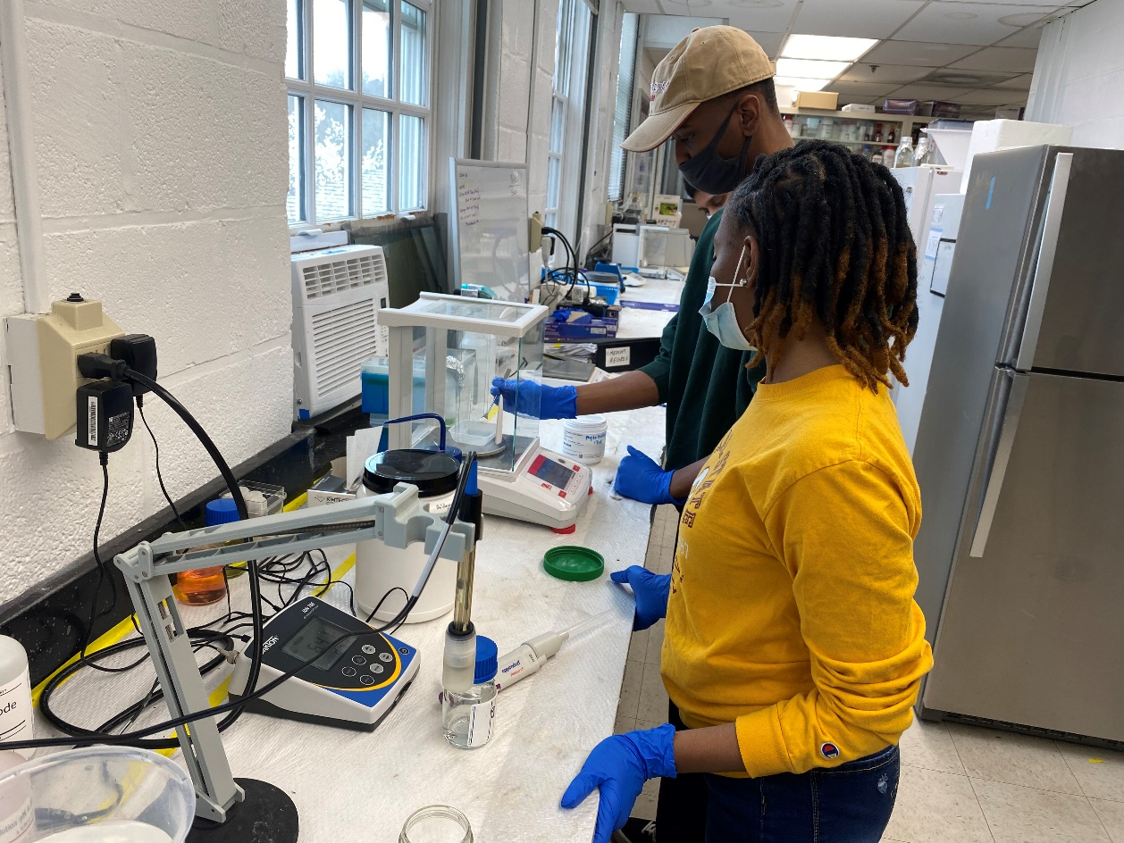
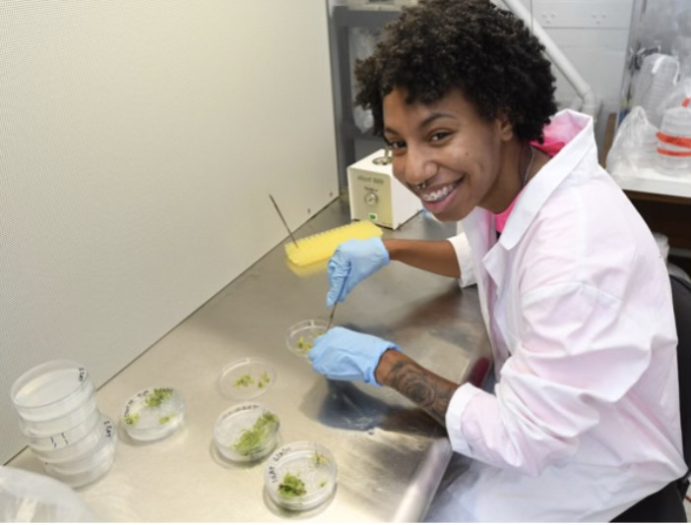
Education and Training in Hemp Tissue Culture
Students preparing tissue culture medium
Practicing hemp tissue culture transfers

